Slide 1
REAL WORLD HYPERMEDIA AT NRK TV
@EINARWH

Slide 2


Slide 3
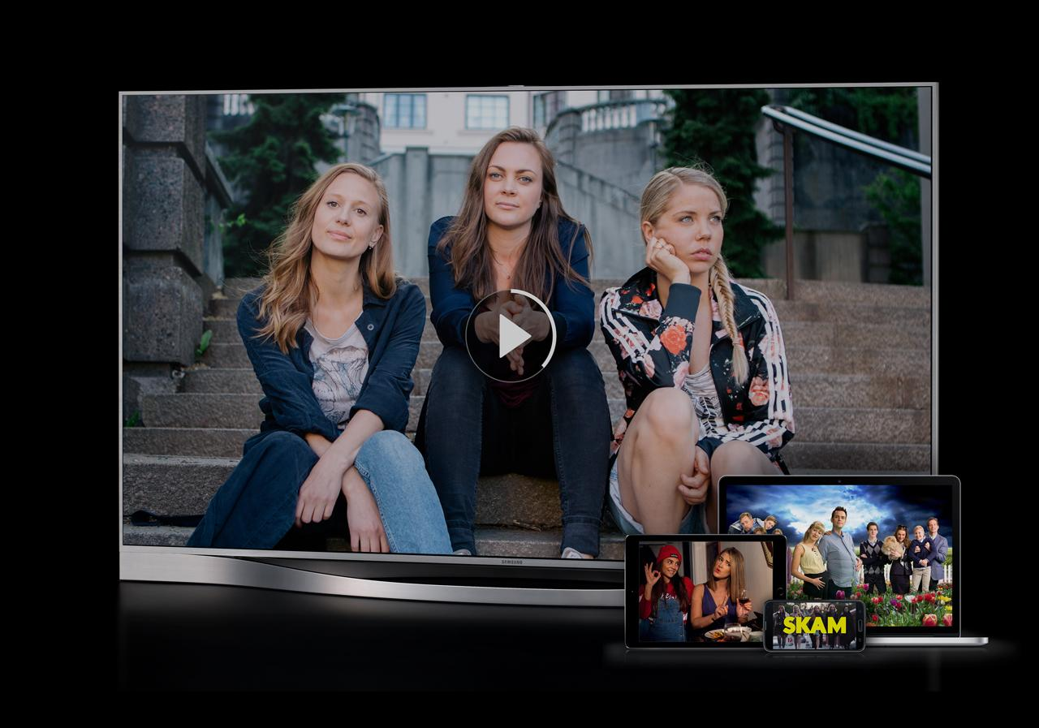

Slide 4
WHY HYPERMEDIA?

Slide 5
BECAUSE IT’S IN VOGUE?

Slide 6
BECAUSE IT’S COOL?

Slide 7
BECAUSE I LIKE IT?

Slide 8
NO!

Slide 9
BECAUSE IT HELPS US!

Slide 10
HYPERMEDIA AS ENABLER FOR BETTER ARCHITECTURE

Slide 11
THIS IS AN ARCHITECTURE TALK

Slide 12
STRANGLING THE MONOLITH WITH HYPERMEDIA

Slide 14
AGENDA

Slide 15
ARCHITECTURE CHALLENGES AT NRK TV

Slide 16
INTRODUCTION TO HYPERMEDIA

Slide 17
HYPERMEDIA IN PRACTICE AT NRK TV

Slide 19
ARCHITECTURE CONCERNS AT NRK TV

Slide 20
SOCIO-TECHNICAL CONTEXT

Slide 21
BUSINESS PERSPECTIVE

Slide 22
RAPIDLY EVOLVING DOMAIN

Slide 23
MUST STAY COMPETITIVE

Slide 24
MUST BE NIMBLE

Slide 25
ORGANIZATION

Slide 26
MULTIPLE TEAMS AT NRK TV

Slide 27
COLLABORATION WITH NRK RADIO AND NRK SUPER

Slide 28
INTERACTIONS WITH OTHER PARTS OF THE ORGANIZATION

Slide 29
WE MUST SUPPORT AUTONOMY

Slide 30
WE MUST SUPPORT EXPERIMENTS

Slide 31
WE MUST SUPPORT CHANGE

Slide 32
WE MUST PROVIDE STABILITY

Slide 33
TECHNICAL PERSPECTIVE

Slide 34
THE NRK TV PLAYER API

Slide 35
MANY CLIENTS

Slide 36
PROGRESSIVE CLIENTS

Slide 37
LEGACY CLIENTS

Slide 38
IMPACT ON ARCHITECTURE

Slide 40
CA 2016

Slide 41
MONOLITHIC WEB API SERVING MANY CLIENTS

Slide 42
RUNS IN AZURE TWO DATA CENTERS

Slide 43
BACKED BY RELATIONAL DATABASE

Slide 44
VARIOUS SUPPORTING WORKER JOBS

Slide 45
CUNNING CACHING SCHEMES

Slide 46
OVERWHELMING COMPLEXITY

Slide 47
LARGELY UNREASONABLE

Slide 48
COMPLEX FAILURE MODES

Slide 49
UNFORESEEN EFFECTS OF CHANGE

Slide 50
FEAR OF CHANGE

Slide 51
RELIANCE ON RELEASE MANAGER GENIUS

Slide 52
HIGH LEAD TIME

Slide 53
STAGNATION

Slide 54
WHAT TO DO?

Slide 55
REWRITE?

Slide 56
WHAT DO YOU MEAN REWRITE?

Slide 57
WE CAN’T REWRITE!

Slide 58
SO HOW DO WE REWRITE?

Slide 59
WE MUST EVOLVE!

Slide 61
WHERE DID THE MONOLITH COME FROM?

Slide 62
THE ENTITY

Slide 63
THE ENTITY IS THE MONOLITH

Slide 64
THE ENTITY SNOWBALLS COMPLEXITY

Slide 65
THE ENTITY IS THE BIG BALL OF MUD

Slide 66
FOR NRK TV THE TV SHOW IS THE ENTITY

Slide 67
WHAT IS A TV SHOW?

Slide 68
ACCESSIBILITY
CDN
MEDIA MANIFEST
BINGE WATCHING
RATING
IMAGES
USAGE RIGHTS
SERIES
EPISODES
FAVORITES
PROMOTIONS
TV
SHOW
TV
SHOW
ON DEMAND
IP CHECK
REPORTING
HIT TITLES
SEARCH
AGE CONTROL
SUBTITLES
CATEGORY
RECOMMENDATIONS
HISTORY
CONTRIBUTORS
POPULARITY
LIVE

Slide 69
WHO’S ASKING?

Slide 70
FUNCTIONAL DECOMPOSITION

Slide 71
BOUNDED CONTEXTS

Slide 72
TV SHOW IN THE CATALOG CONTEXT

Slide 73
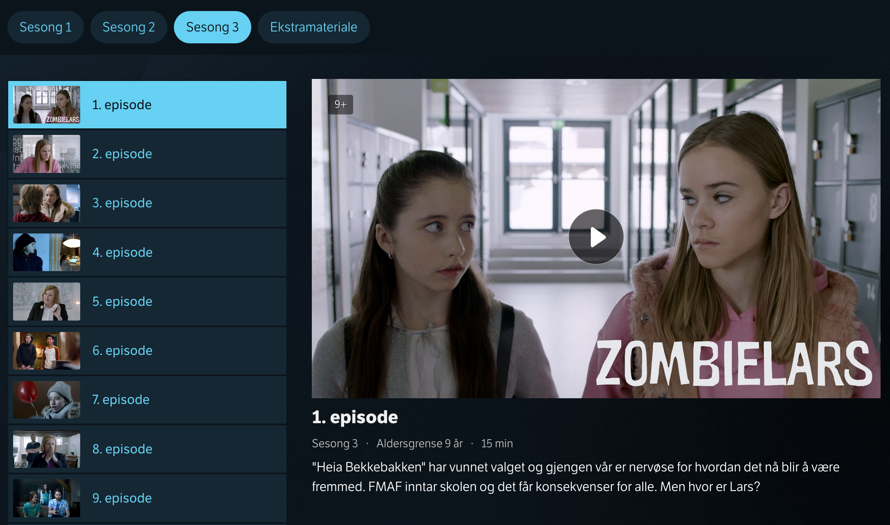

Slide 74
COMPLEXITY WITH RESPECT TO

Slide 75
METADATA DESCRIBING THE MEDIA CONTENT

Slide 76
WHAT KINDS OF TV SHOWS ARE THERE?

Slide 77
HOW SHOULD THEY BE PRESENTED?

Slide 78
WHAT’S THEIR LOGIC?

Slide 79
A TV SERIES WITH EPISODES IS DIFFERENT FROM THE DAILY NEWS IS DIFFERENT FROM A SPORTS EVENT IS DIFFERENT FROM A TALK SHOW IS DIFFERENT FROM A DOCUMENTARY IS DIFFERENT FROM …

Slide 80
DIFFERENT CONTENT IS CONSUMED DIFFERENTLY

Slide 81
TV SHOW IN THE PLAYBACK CONTEXT

Slide 82
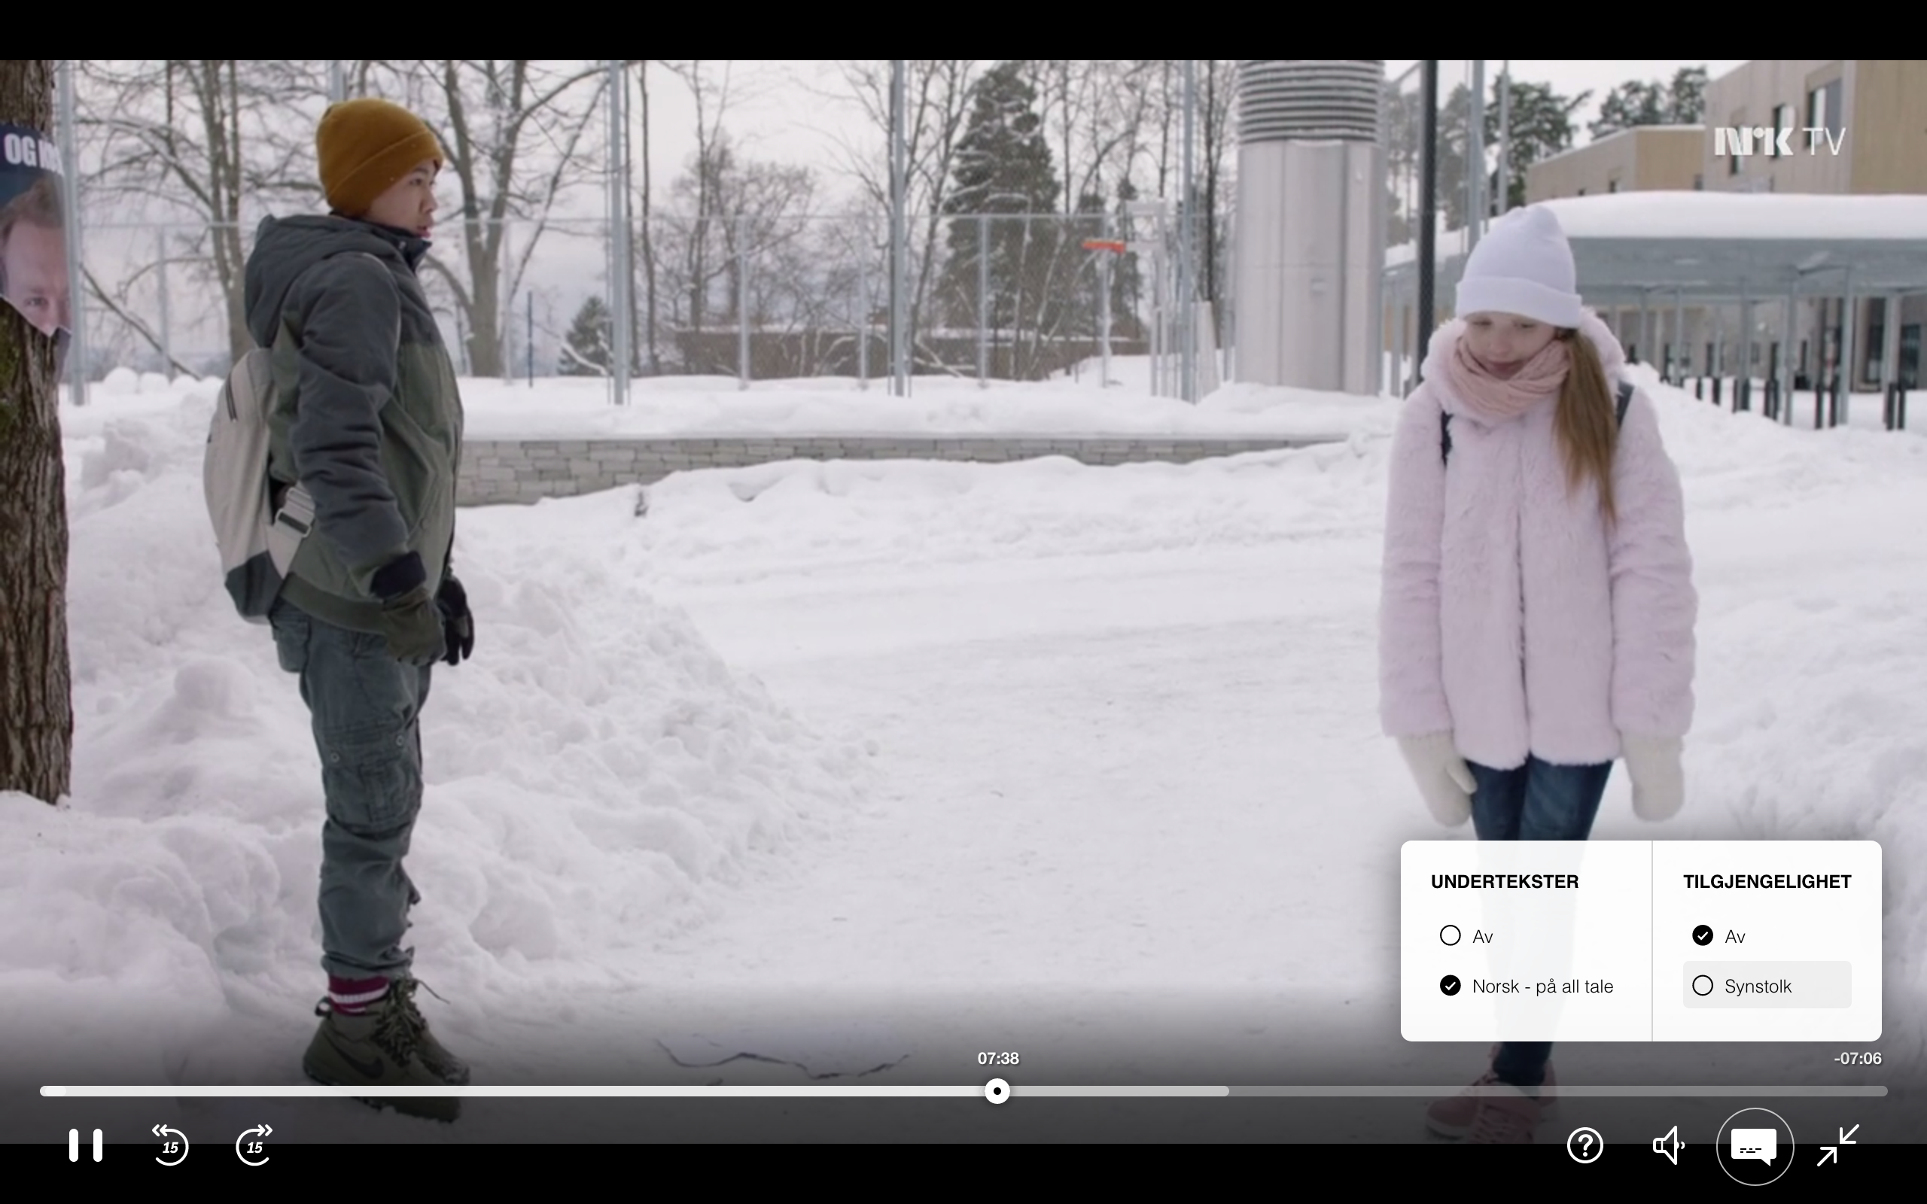

Slide 83
COMPLEXITY WITH RESPECT TO

Slide 84
PLAYING THE ACTUAL MEDIA CONTENT

Slide 85
SUPPORT FOR VARIOUS KINDS OF MEDIA MANIFESTS

Slide 86
STREAMING QUALITY

Slide 87
ADAPTING BIT RATE TO DEVICE AND NETWORK

Slide 88
SUPPORTING ACCESSIBILITY VERSIONS

Slide 89
WHAT ABOUT OTHER CONTEXTS?

Slide 90
CATALOG
DESKING
SEARCH
TV
SHOW
RECOMMEND
ATIONS
PERSONAL IZATION
PLAYBACK

Slide 91
CONTAINMENT OF COMPLEXITY

Slide 92
DIFFERENT GOALS AND REQUIREMENTS

Slide 93
CATALOG
DESKING
SEARCH
TV
SHOW
RECOMMEND
ATIONS
PERSONAL IZATION
PLAYBACK

Slide 94
CATALOG
DESKING
SEARCH
CRITICALITY?
TV
SHOW
RECOMMEND
ATIONS
PERSONAL IZATION
PLAYBACK

Slide 95
CATALOG
DESKING
SEARCH
TV
SHOW
RECOMMEND
ATIONS
PERSONAL IZATION
PLAYBACK

Slide 96
CATALOG
DESKING
SEARCH
TV
SHOW
RECOMMEND
ATIONS
PERSONAL IZATION
PLAYBACK

Slide 97
CATALOG
DESKING
SEARCH
TV
SHOW
RECOMMEND
ATIONS
PERSONAL IZATION
PLAYBACK

Slide 98
CATALOG
DESKING
SEARCH
CACHING?
TV
SHOW
RECOMMEND
ATIONS
PERSONAL IZATION
PLAYBACK

Slide 99
CATALOG
DESKING
SEARCH
TV
SHOW
RECOMMEND
ATIONS
PERSONAL IZATION
PLAYBACK

Slide 100
CATALOG
DESKING
SEARCH
TV
SHOW
RECOMMEND
ATIONS
PERSONAL IZATION
PLAYBACK

Slide 101
CATALOG
DESKING
SEARCH
TV
SHOW
RECOMMEND
ATIONS
PERSONAL IZATION
PLAYBACK

Slide 102
CATALOG
DESKING
SEARCH
FAILURES?
TV
SHOW
RECOMMEND
ATIONS
PERSONAL IZATION
PLAYBACK

Slide 103
CATALOG
DESKING
SEARCH
TV
SHOW
RECOMMEND
ATIONS
PERSONAL IZATION
PLAYBACK

Slide 104
CATALOG
DESKING
SEARCH
TV
SHOW
RECOMMEND
ATIONS
PERSONAL IZATION
PLAYBACK

Slide 105
UNIFORMLY CRITICAL

Slide 106
NOT EASILY CACHEABLE

Slide 107
NO PARTIAL SUCCESS

Slide 108
PRONE TO FAIL HARD

Slide 109
HARD TO REASON ABOUT

Slide 111
WHAT TO DO?

Slide 112
LOBBY FOR AND ELECT AN ARCHITECT

Slide 113
BOUNDED CONTEXT AS SERVICE BOUNDARY

Slide 114
NEW STUFF AS NEW SERVICES

Slide 115
GATEWAY AS ARCHITECTURE SEAM

Slide 116
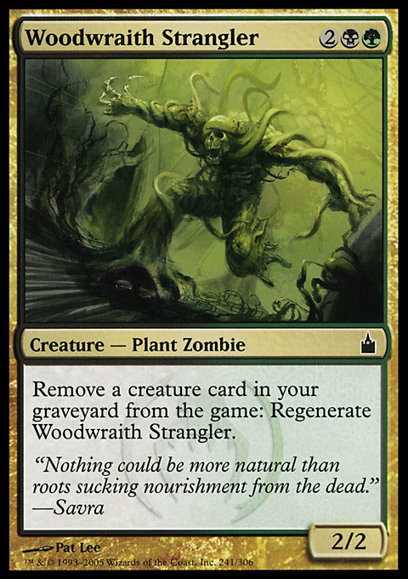
STRANGLER PATTERN

Slide 117
EXPERIMENT WITH HYPERMEDIA

Slide 118
RECOMPOSE WHAT WE DECOMPOSE

Slide 119
NAVIGATE SEAMLESSLY ACROSS BOUNDARIES

Slide 120
INTEGRATED EXPERIENCE

Slide 122
WHAT IS HYPERMEDIA?

Slide 123
MEDIA WITH LINKS

Slide 124
LINKS HAVE SEMANTICS

Slide 125
LINK RELATIONS

Slide 126
LINK PRESENCE IS DYNAMIC AND MEANINGFUL

Slide 127
LINKS AS AFFORDANCES

Slide 128
LINKS TURN RESOURCES INTO JUNCTIONS

Slide 129
LINKS ANSWER THE QUESTION: NOW WHAT?

Slide 130
THERE SHOULD BE A LINK FOR EACH WAY FORWARD

Slide 131
RESOURCES CONNECT TO FORM NARRATIVES

Slide 159
5XX

Slide 160
5XX

Slide 161
5XX

Slide 162
5XX

Slide 166
PLAYBACK
CATALOG
PERSONAL IZATION
DESKING

Slide 167
PLAYBACK
CATALOG
PERSONAL IZATION
DESKING

Slide 168
EVOLUTION & VERSIONING

Slide 169
THE CLASSICAL QUESTION: WHICH VERSIONING SCHEME?

Slide 170
NOT REALLY RELEVANT

Slide 171
RARELY USEFUL TO REPLACE INDIVIDUAL ENDPOINTS

Slide 172
OFFER NEW AND IMPROVED NARRATIVES

Slide 173
USE LINKS TO OFFER NEW ALTERNATIVES TO CLIENTS

Slide 174
IDENTIFY NARRATIVES BY LINK RELATIONS

Slide 175
LET THE CLIENT OPT-IN TO NEW ALTERNATIVES

Slide 176
WE CAN TRACK WHICH CLIENTS USE WHICH NARRATIVES

Slide 177
CLIENTS SELF-IDENTIFY THROUGH USER AGENT HEADER

Slide 178
EVENTUALLY REMOVE LINKS TO OBSOLETE NARRATIVES

Slide 179
CATALOG
PLAYBACK
PERSONAL IZATION
DESKING

Slide 180
LEGACY
CATALOG
PLAYBACK
PERSONAL IZATION
DESKING

Slide 181
LEGACY
CATALOG
PLAYBACK
EPISODE
SERIES
SERIES
PERSONAL IZATION
DESKING

Slide 182
LEGACY
CATALOG
PLAYBACK
EPISODE
SERIES
SERIES
PERSONAL IZATION
TV SHOW PAGES
DESKING

Slide 183
LEGACY
CATALOG
PLAYBACK
EPISODE
PROGRAMPAGE
SERIES
showpage
SERIES
PERSONAL IZATION
showpage
TV SHOW PAGES
DESKING

Slide 184
LEGACY
CATALOG
PLAYBACK
EPISODE
SERIES
SERIES
PERSONAL IZATION
DESKING

Slide 185
LEGACY
CATALOG
PLAYBACK
EPISODE
PROGRAMPAGE
SERIES
showpage
SERIES
PERSONAL IZATION
showpage
TV SHOW PAGES
DESKING

Slide 186
LEGACY
CATALOG
PLAYBACK
EPISODE
PROGRAMPAGE
SERIES
showpage
SERIES
PERSONAL IZATION
showpage
TV SHOW PAGES
DESKING

Slide 187
LEGACY
CATALOG
PLAYBACK
EPISODE
PROGRAMPAGE
SERIES
showpage
SERIES
PERSONAL IZATION
showpage
TV SHOW PAGES
DESKING

Slide 188
LEGACY
CATALOG
PLAYBACK
EPISODE
PROGRAMPAGE
SERIES
showpage
SERIES
PERSONAL IZATION
showpage
TV SHOW PAGES
DESKING

Slide 189
LEGACY
CATALOG
PLAYBACK
EPISODE
PROGRAMPAGE
SERIES
showpage
SERIES
PERSONAL IZATION
showpage
TV SHOW PAGES
DESKING

Slide 190
PLAYBACK
PROGRAMPAGE
showpage
PERSONAL IZATION
showpage
TV SHOW PAGES
DESKING

Slide 191
HYPERMEDIA APPLICATION LANGUAGE

Slide 192
WHY HAL?

Slide 193
LIGHTWEIGHT

Slide 194
GRADUAL

Slide 195
RESOURCES HAVE LINKS AND STATE

Slide 196
RESOURCES MAY HAVE EMBEDDED RESOURCES

Slide 197
LINKS HAVE A TARGET AND A RELATION

Slide 198
HAL EXAMPLES

Slide 199
{
"_links":
{
"self":
{
"href": "tv/series/skam"
}
}
}

Slide 200
COLLECTION OF LINKS
{
"_links":
{
"self":
{
"href": "tv/series/skam"
}
}
}

Slide 201
{
"_links":
{
"self":
{
"href": "tv/series/skam"
}
}
}
LINK RELATION

Slide 202
{
"_links":
{
"self":
{
"href": "tv/series/skam"
}
}
}
TARGET

Slide 203
{
"_links":
{
"self":
{
"href": "tv/series/skam"
}
}
}
URI

Slide 204
COLLECTION OF LINKS
{
"_links": { "self": { "href": "/tv-show/1" }, "manifest": [{ "name": "default", "href": "/manifest/1" }, { "name": "synstolk", "href": "/manifest/2" }] }
}

Slide 205
{
"_links": { "self": { "href": "/tv-show/1" }, "manifest": [{ "name": "default", "href": "/manifest/1" }, { "name": "synstolk", "href": "/manifest/2" }] }
}
LINK RELATIONS

Slide 206
{
"_links": { "self": { "href": "/tv-show/1" }, "manifest": [{ "name": "default", "href": "/manifest/1" }, { "name": "synstolk", "href": "/manifest/2" }] }
}
NAME AS SECONDARY KEY

Slide 207
COLLECTION OF LINKS
{
"_links": { "self": {
"href": "/tv-show/1"
"progress": { "href": "/progress/{user}/1", "templated": true } }
}

Slide 208
{
"_links": { "self": {
"href": "/tv-show/1"
"progress": { "href": "/progress/{user}/1", "templated": true } }
}
LINK RELATIONS

Slide 209
{
"_links": { "self": {
"href": "/tv-show/1"
"progress": { "href": "/progress/{user}/1", "templated": true } }
}
TEMPLATED LINK

Slide 210
COLLECTION OF EMBEDDED RESOURCES
{ "_embedded": {
"favorite": { "_links": { "self": {
"href": "/tv-show/1" }
}
} }
}

Slide 211
{ "_embedded": {
"favorite": { "_links": { "self": {
"href": "/tv-show/1" }
}
} }
}
LINK RELATION

Slide 212
{ "_embedded": {
"favorite": { "_links": { "self": {
"href": "/tv-show/1" }
}
} }
}
EMBEDDED RESOURCE

Slide 213
EXAMPLES tv.nrk.no

Slide 214

DESKING

Slide 215
DESKING
{ "series": { "_links": { "self": { "href": "/series/heimebane" }, "image": { "href": "https://gfx.nrk.no/GKrIe1kJr" } }, "usageRights": { "isGeoBlocked": false }
}
}
EMBEDDED SERIES RESOURCE

Slide 216
DESKING
{ "series": { "_links": { "self": { "href": "/series/heimebane" }, "image": { "href": "https://gfx.nrk.no/GKrIe1kJr" } }, "usageRights": { "isGeoBlocked": false }
}
}
GO TO CATALOG CONTEXT

Slide 217
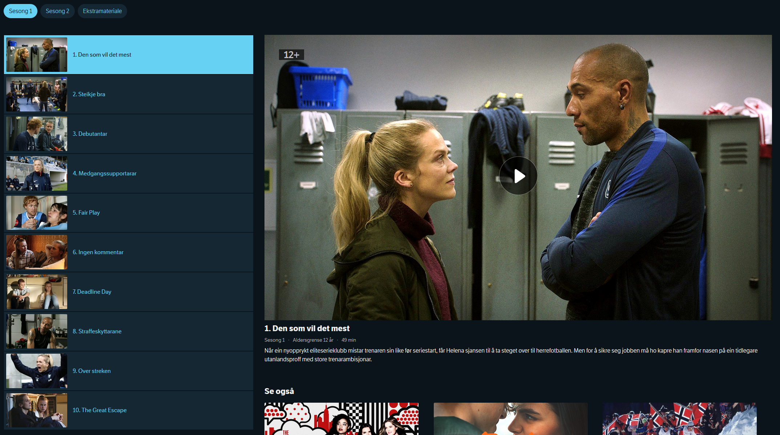
CATALOG
{ "_embedded": {
"episode": [{
"_links": {
"self": {
"href": "/programs/MDRI20000115"
},
"playback": {
"href": "/manifest/MDRI20000115"
},
"share": {
"href": "https://tv.nrk.no/se? v=MDRI20000115{&autoplay,t}",
"templated": true
} },
"title": "1. Den som vil det mest", "productionYear": 2018, "rating": "12+", ... }] } }
EMBEDDED EPISODE RESOURCE

Slide 218
CATALOG
{ "_embedded": {
"episode": [{
"_links": {
"self": {
"href": "/programs/MDRI20000115"
},
"playback": {
"href": "/play/MDRI20000115"
},
"share": {
"href": "https://tv.nrk.no/se? v=MDRI20000115{&autoplay,t}",
"templated": true
} },
"title": "1. Den som vil det mest", "productionYear": 2018, "rating": "12+", ... }] } }
GO TO PLAYBACK CONTEXT

Slide 219
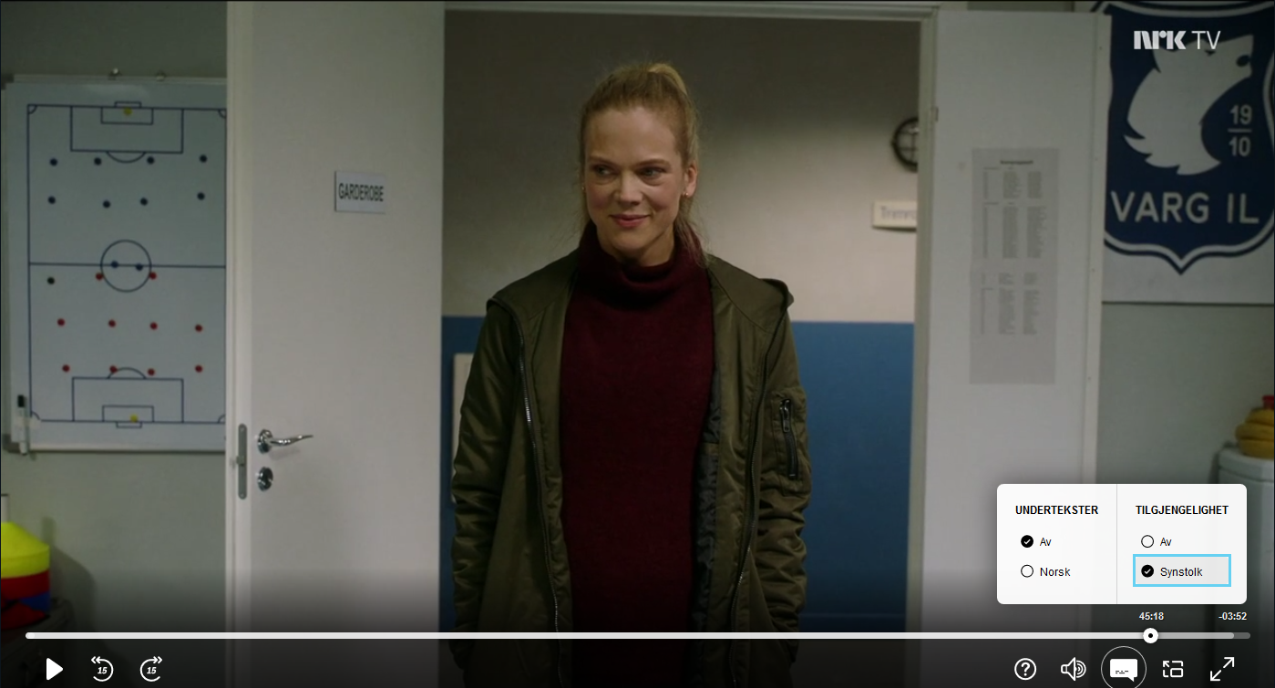
PLAYBACK
{ "_links": {
"self": {
"href": "/play/MDRI20000115"
},
"manifest": [{ "name": "default",
"href": "/manifest/MDRI20000115"
}, { "name": "synstolk",
"href": "/manifest/MDRI20000115SYNS"
}],
"next": {
"href": "/play/MDRI20000215" }, "series": {
"href": "/play/MDRI20000215" }, "progress": {
"href": "/progress/{user}/MDRI20000215", "templated": true } }, "duration": "PT49M10.92S", ... }
EPISODE PLAYBACK RESOURCE
GO TO PLAYBACK CONTEXT

Slide 220
PLAYBACK
{ "_links": {
"self": {
"href": "/play/MDRI20000115"
},
"manifest": [{ "name": "default",
"href": "/manifest/MDRI20000115"
}, { "name": "synstolk",
"href": "/manifest/MDRI20000115SYNS"
}],
"next": {
"href": "/play/MDRI20000215" }, "series": {
"href": "/series/heimebane" }, "progress": {
"href": "/progress/{user}/MDRI20000215", "templated": true } }, "duration": "PT49M10.92S", ... }
EPISODE PLAYBACK RESOURCE
GO TO PLAYBACK CONTEXT

Slide 221
PLAYBACK
{ "_links": {
"self": {
"href": "/play/MDRI20000115"
},
"manifest": [{ "name": "default",
"href": "/manifest/MDRI20000115"
}, { "name": "synstolk",
"href": "/manifest/MDRI20000115SYNS"
}],
"next": {
"href": "/play/MDRI20000215" }, "series": {
"href": "/series/heimebane" }, "progress": {
"href": "/progress/{user}/MDRI20000215", "templated": true } }, "duration": "PT49M10.92S", ... }
RESOLVE MANIFEST URL
GO TO PLAYBACK CONTEXT

Slide 222
PLAYBACK
{ "_links": {
"self": {
"href": "/play/MDRI20000115"
},
"manifest": [{ "name": "default",
"href": "/manifest/MDRI20000115"
}, { "name": "synstolk",
"href": "/manifest/MDRI20000115SYNS"
}],
"next": {
"href": "/play/MDRI20000215" }, "series": {
"href": "/series/heimebane" }, "progress": {
"href": "/progress/{user}/MDRI20000215", "templated": true } }, "duration": "PT49M10.92S", ... }
ACCESSIBILITY OPTION
GO TO PLAYBACK CONTEXT

Slide 223
PLAYBACK
{ "_links": {
"self": {
"href": "/play/MDRI20000115"
},
"manifest": [{ "name": "default",
"href": "/manifest/MDRI20000115"
}, { "name": "synstolk",
"href": "/manifest/MDRI20000115SYNS"
}],
"next": {
"href": "/play/MDRI20000215" }, "series": {
"href": "/series/heimebane" }, "progress": {
"href": "/progress/{user}/MDRI20000215", "templated": true } }, "duration": "PT49M10.92S", ... }
PLAY NEXT EPISODE
GO TO PLAYBACK CONTEXT

Slide 224
PLAYBACK
{ "_links": {
"self": {
"href": "/play/MDRI20000115"
},
"manifest": [{ "name": "default",
"href": "/manifest/MDRI20000115"
}, { "name": "synstolk",
"href": "/manifest/MDRI20000115SYNS"
}],
"next": {
"href": "/play/MDRI20000215" }, "series": {
"href": "/series/heimebane" }, "progress": {
"href": "/progress/{user}/MDRI20000215", "templated": true } }, "duration": "PT49M10.92S", ... }
BACK TO CATALOG CONTEXT
GO TO PLAYBACK CONTEXT

Slide 225
PLAYBACK
{ "_links": {
"self": {
"href": "/play/MDRI20000115"
},
"manifest": [{ "name": "default",
"href": "/manifest/MDRI20000115"
}, { "name": "synstolk",
"href": "/manifest/MDRI20000115SYNS"
}],
"next": {
"href": "/play/MDRI20000215" }, "series": {
"href": "/series/heimebane" }, "progress": {
"href": "/progress/{user}/MDRI20000215", "templated": true } }, "duration": "PT49M10.92S", ... }
GO TO PLAYBACK CONTEXT
REPORT VIEWING PROGRESS

Slide 226
2019

Slide 227
THE MONOLITH IS SHRINKING

Slide 228
NO RELEASE MANAGER

Slide 229
INDEPENDENT DEPLOYS

Slide 230
LOWER LEAD TIMES

Slide 231
LESS DRAMATIC OUTAGES

Slide 232
PLAYBACK

Slide 233
TV SHOW PAGES

Slide 234
PERSONALIZATION

